Slide 1
When Tenants Got Their Own Lands: The Effect of Taiwan’s Land Reform in 1953 on Agriculture Output
Bob Lin. April 2022

Slide 2
Land Reform could Boost Economic Development
Land Reform: Redistributing ownership of farmland from wealthy landowner to poor tenants
Studwell (2013) : Land reform incentivized small farmers, raised agricultural production and savings, and hence provided an initial productive surplus for future industrial development in the East Asian countries
Boyce et al. (2005): Land reform brough relatively egalitarian distribution of wealth and income, enabling governors to implement economic growth policy more effectively without compromising to interest group and by reducing rent-seeking behavior.

Slide 3
Past Literature Mainly Uses Country-Level Time Series Data but Hardly Built Causality
Case study; regression of input on output with time series data
Land reforms in the post-war period and enjoy high economic growth after 1960s
Japan (1946~1950): Kawagoe, 1999
Korea (1945~1950): Jeon and Kim, 2000
Taiwan (1949~1953): Koo, 1968

Slide 4
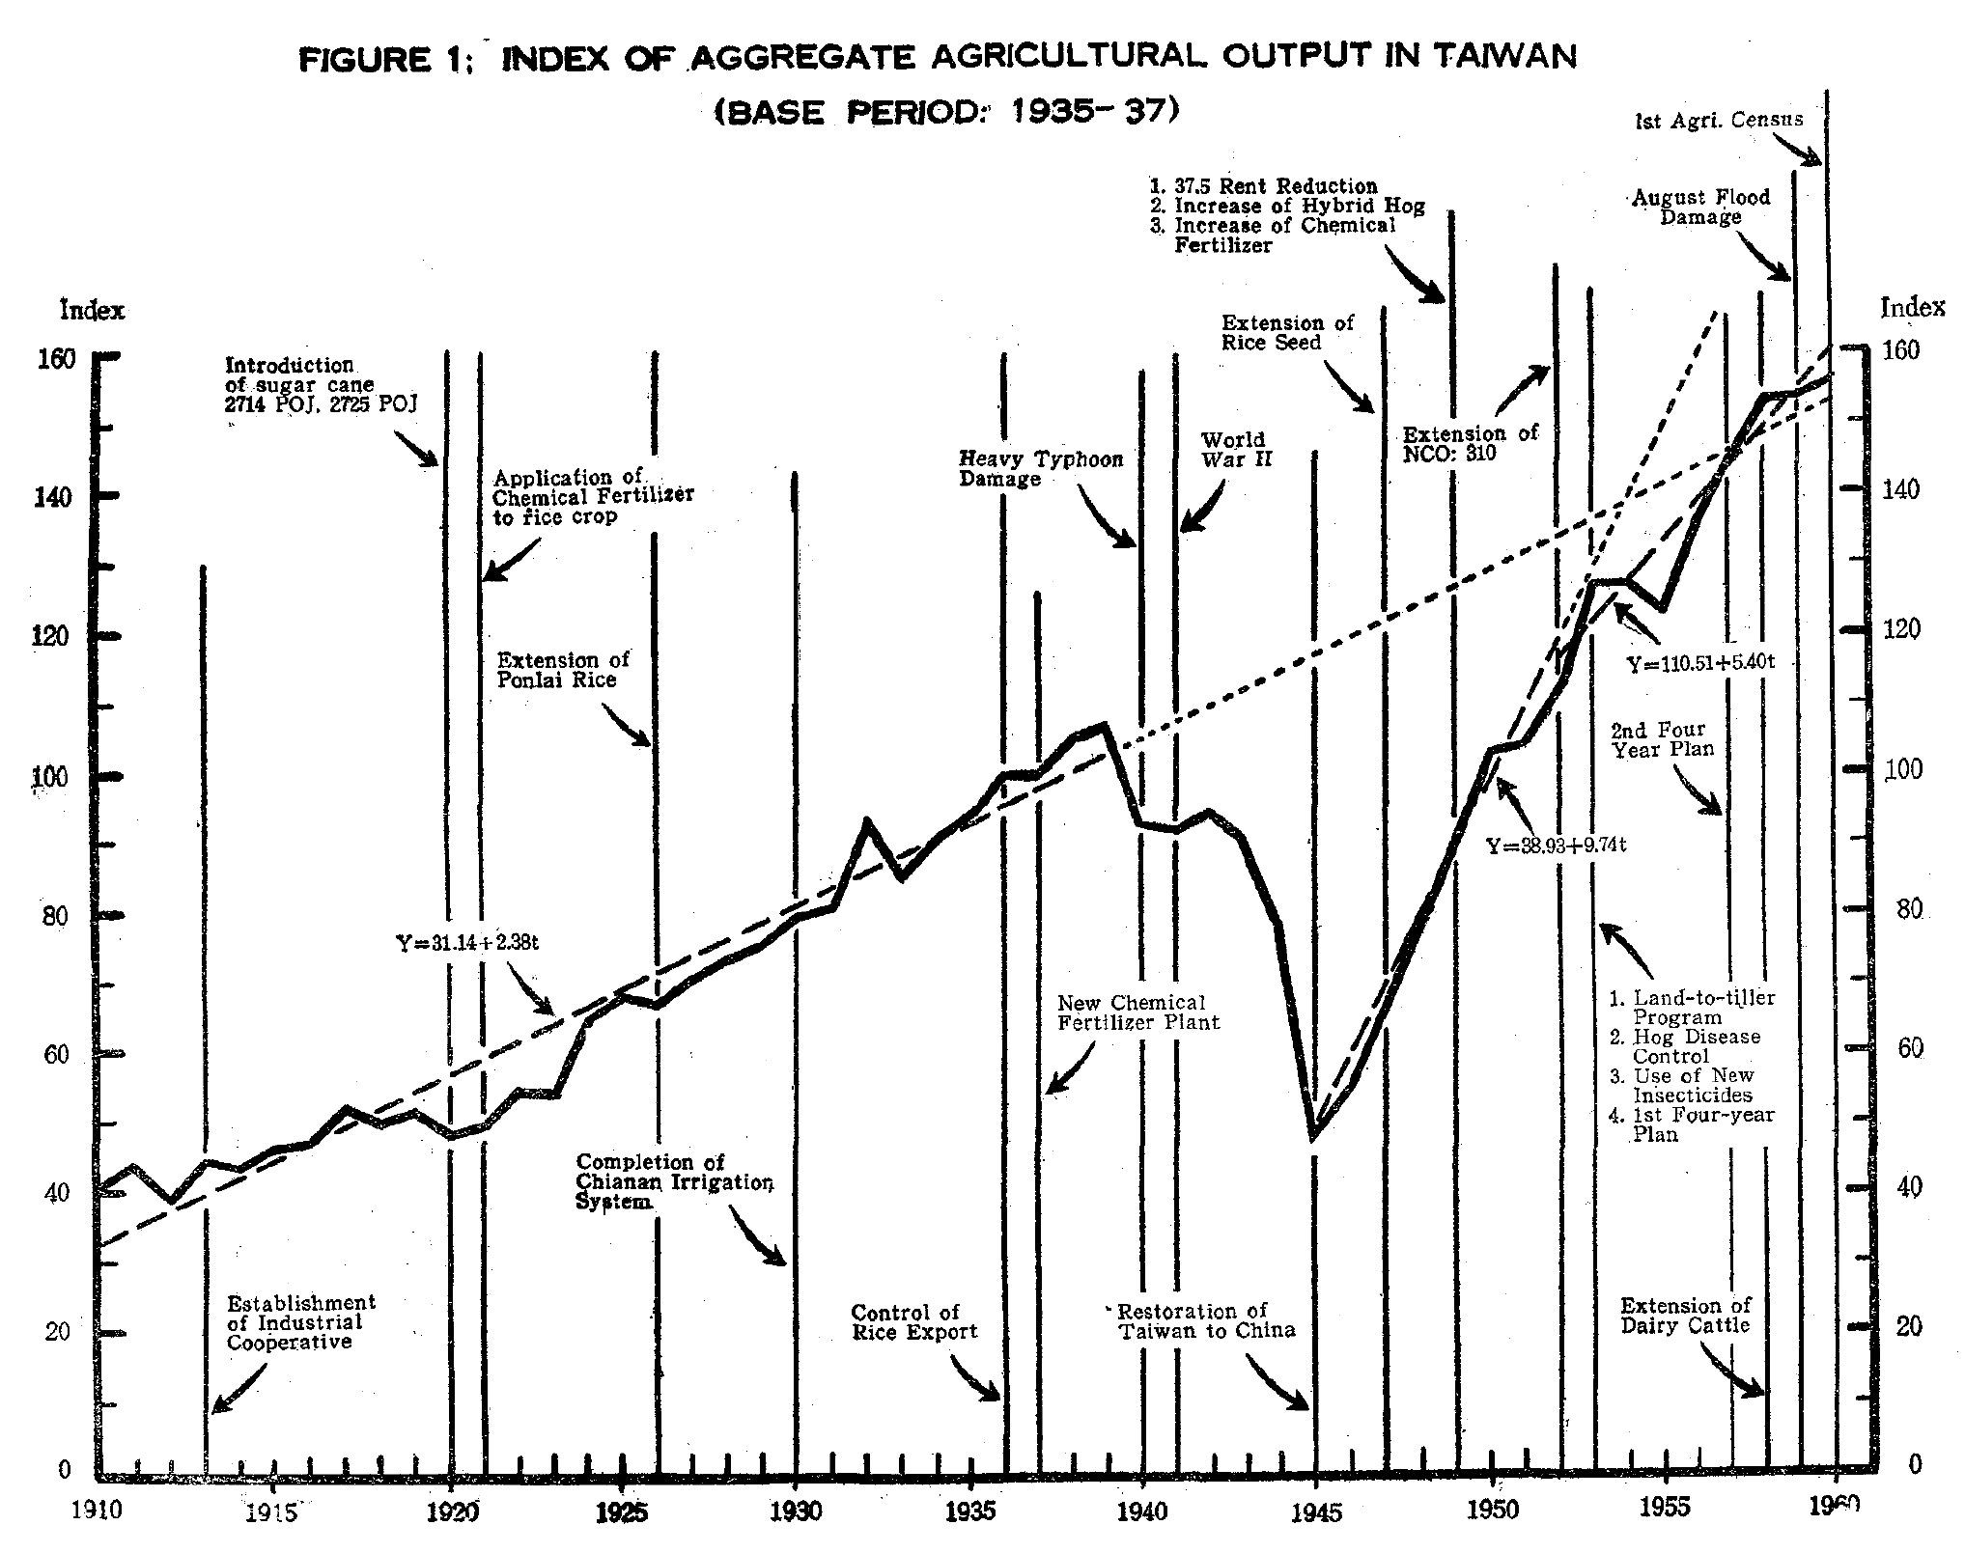
Taiwan’s Agriculture Was Fast-Changing

Slide 5
Some Recent Literature Uses Micro Data and Gets Different Results in Different Countries
Adamopoulos and Restuccia, 2020
Mendola and Simtowe, 2014
Ghatak and Roy, 2007

Slide 6
Utilize the Regional Variations in Affected Levels by Land Reform to Identify its Effect

Slide 7
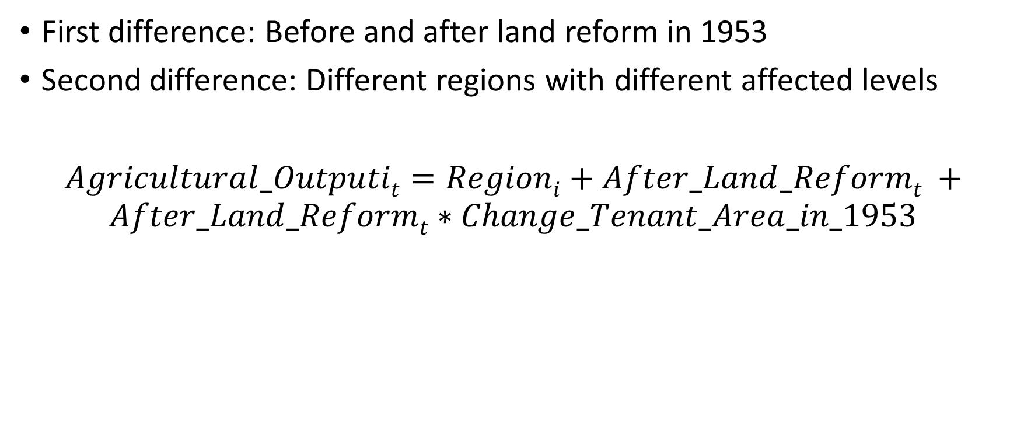
Difference-in-Differences with a Continuous Treatment
First difference: Before and after land reform in 1953
Second difference: Different regions with different affected levels
$Agricultural_Outputit=Regioni+After_Land_Reformt +$ $After_Land_Reformt∗Change_Tenant_Area_in_1953$

Slide 9
Result
 | total_value | total_value (1953) | total_value (1954) | total_value (1955) | total_value (1956) | rice_total_value | rice_total_value (1953) | rice_total_value (1954) | rice_total_value (1955) | rice_total_value (1956)
after_reform | 1.00e+08*** | 4.80e+07*** | 4.34e+07*** | 8.37e+07*** | 1.00e+08*** | 3.89e+07*** | 1.79e+07*** | 1.98e+07** | 3.40e+07** | 2.81e+07***
 | (2.85e+07) | (1.55e+07) | (1.40e+07) | (2.60e+07) | (2.73e+07) | (1.33e+07) | (5871714) | (8150534) | (1.26e+07) | (8790888)
after_tenant_area_change | 19266.26*** | 12729.28*** | 4542.765 | 12927.35** | 18019.96*** | 11099.08*** | 8906.505*** | 1159.928 | 4816.792* | 8789.62***
 | (5840.986) | (3312.881) | (2799.946) | (5294.401) | (5540.529) | (2691.854) | (1308.877) | (1735.044) | (2545.4) | (1630.339)
Regional fixed effects | YES | YES | YES | YES | YES | YES | YES | YES | YES | YES
R2 | 0.6484888 | 0.7807647 | 0.6714055 | 0.7640779 | 0.8302784 | 0.5936727 | 0.8020624 | 0.3513128 | 0.5837387 | 0.7962743
N | 154 | 44 | 44 | 44 | 44 | 154 | 44 | 44 | 44 | 44

Slide 10
Result
 | common_crop_ex_rice_value | common_crop_ex_rice_value (1953) | common_crop_ex_rice_value (1954) | common_crop_ex_rice_value (1955) | common_crop_ex_rice_value (1956) | special_crop_value | special_crop_value (1953) | special_crop_value (1954) | special_crop_value (1955) | special_crop_value (1956)
after_reform | 1.24e+07** | 2486230 | 4589148** | 9115548** | 1.38e+07** | 1.69e+07** | 1.42e+07* | 3482730* | 1.16e+07* | 2.09e+07**
 | (5236061) | (1684283) | (1911785) | (4011038) | (6294835) | (7557564) | (7422569) | (2013743) | (5948014) | (9634661)
after_tenant_area_change | 2090.673* | 602.5843* | 690.0494* | 1726.753* | 2599.027* | 3054.111* | 2441.301 | 779.229** | 2736.942** | 2414.757
 | (1170.302) | (321.8474) | (346.8062) | (856.8391) | (1396.77) | (1621.54) | (1722.505) | (371.8529) | (1163.012) | (2041.047)
Regional fixed effects | YES | YES | YES | YES | YES | YES | YES | YES | YES | YES
R2 | 0.3931075 | 0.3289457 | 0.5898917 | 0.6077087 | 0.6094285 | 0.3749466 | 0.482832 | 0.4555352 | 0.6390564 | 0.4841564
N | 154 | 44 | 44 | 44 | 44 | 154 | 44 | 44 | 44 | 44

Slide 11
Result
 | horticultural_crop_value | horticultural_crop_value (1953) | horticultural_crop_value (1954) | horticultural_crop_value (1955) | horticultural_crop_value (1956) | livestock_value | livestock_value (1953) | livestock_value (1954) | livestock_value (1955) | livestock_value (1956)
after_reform | 4646947*** | 637979.1 | 2671437** | 4926859** | 5415184** | 2.74e+07*** | 1.28e+07*** | 1.28e+07** | 2.40e+07*** | 3.19e+07***
 | (1410207) | (474884.1) | (991503.7) | (1901319) | (2348230) | (6762346) | (4091109) | (5222746) | (6510905) | (7429283)
after_tenant_area_change | 647.8904** | 160.5143** | 257.185 | 753.6509* | 1138.216** | 2372.474** | 618.0004 | 1656.067** | 2891.55** | 3077.557**
 | (262.9587) | (61.32668) | (177.0798) | (363.4441) | (438.5109) | (892.1735) | (542.5956) | (623.5277) | (1031.518) | (1128.794)
Regional fixed effects | YES | YES | YES | YES | YES | YES | YES | YES | YES | YES
R2 | 0.3954844 | 0.5241751 | 0.4734333 | 0.6924006 | 0.7328509 | 0.581189 | 0.7385233 | 0.7277741 | 0.7624913 | 0.7842766
N | 154 | 44 | 44 | 44 | 44 | 154 | 44 | 44 | 44 | 44

Slide 12
Ln Result
 | ln_total_value | ln_total_value (1953) | ln_total_value (1954) | ln_total_value (1955) | ln_total_value (1956) | ln_rice_total_value | ln_rice_total_value (1953) | ln_rice_total_value (1954) | ln_rice_total_value (1955) | ln_rice_total_value (1956)
after_reform | .7726796*** | .307432*** | .2459267*** | .4675975*** | .571586*** | .8792307*** | .3765168*** | .2627443*** | .4847848*** | .5094684***
 | (.0345719) | (.0306892) | (.0519085) | (.0405045) | (.0676413) | (.0255681) | (.0184575) | (.035731) | (.0351272) | (.0429961)
after_tenant_area_change | 4.16e-06 | 8.21e-06** | -1.97e-06 | -3.29e-07 | 1.69e-06 | -2.60e-06 | 6.25e-06*** | -.0000114** | -.0000131*** | -2.09e-06
 | (3.87e-06) | (2.94e-06) | (5.35e-06) | (4.66e-06) | (6.34e-06) | (2.71e-06) | (1.99e-06) | (4.48e-06) | (4.34e-06) | (3.93e-06)
Regional fixed effects | YES | YES | YES | YES | YES | YES | YES | YES | YES | YES
R2 | 0.7289537 | 0.9598608 | 0.7864314 | 0.9489629 | 0.9455587 | 0.7312347 | 0.9853665 | 0.7473815 | 0.9146412 | 0.9657968
N | 154 | 44 | 44 | 44 | 44 | 147 | 42 | 42 | 42 | 42

Slide 13
Ln Result
 | ln_common_crop_ex_rice_value | ln_common_crop_ex_rice_value (1953) | ln_common_crop_ex_rice_value (1954) | ln_common_crop_ex_rice_value (1955) | ln_common_crop_ex_rice_value (1956) | ln_special_crop_value | ln_special_crop_value (1953) | ln_special_crop_value (1954) | ln_special_crop_value (1955) | ln_special_crop_value (1956)
after_reform | .7260609*** | .0476628 | .2281613** | .4124172*** | .5301231*** | .460493** | .0614688 | -.3995987 | .0048327 | .1843442
 | (.0938104) | (.0970289) | (.0873192) | (.0819098) | (.1222348) | (.1893621) | (.3685838) | (.3709205) | (.3871386) | (.3530578)
after_tenant_area_change | 6.48e-06 | .0000161* | 7.22e-06 | .0000126 | .0000174 | .0000283 | .0000298 | .0000552 | .0000473 | .0000231
 | (9.00e-06) | (8.44e-06) | (7.90e-06) | (8.83e-06) | (.0000116) | (.0000184) | (.0000339) | (.000033) | (.0000341) | (.0000352)
Regional fixed effects | YES | YES | YES | YES | YES | YES | YES | YES | YES | YES
R2 | 0.6220981 | 0.3229732 | 0.5693207 | 0.7935653 | 0.8244311 | 0.3320174 | 0.1304166 | 0.1400363 | 0.1985167 | 0.1737101
N | 154 | 44 | 44 | 44 | 44 | 154 | 44 | 44 | 44 | 44

Slide 14
Ln Result
 | ln_horticultural_crop_value | ln_horticultural_crop_value (1953) | ln_horticultural_crop_value (1954) | ln_horticultural_crop_value (1955) | ln_horticultural_crop_value (1956) | ln_livestock_value | ln_livestock_value (1953) | ln_livestock_value (1954) | ln_livestock_value (1955) | ln_livestock_value (1956)
after_reform | .4803975*** | .0594357 | .2348209*** | .3779604*** | .3818754*** | .8460795*** | .3324351*** | .2828382* | .6249594*** | .7291973***
 | (.0648284) | (.0391027) | (.0574823) | (.0639577) | (.0772488) | (.0712833) | (.0387801) | (.1638593) | (.0723023) | (.0765718)
after_tenant_area_change | -4.81e-06 | 3.19e-06 | -4.61e-06 | 3.63e-06 | .0000141* | .000012* | 4.17e-06 | .0000228 | .0000166** | .0000158*
 | (5.46e-06) | (3.38e-06) | (5.16e-06) | (6.55e-06) | (7.64e-06) | (6.74e-06) | (7.18e-06) | (.000015) | (7.75e-06) | (7.63e-06)
Regional fixed effects | YES | YES | YES | YES | YES | YES | YES | YES | YES | YES
R2 | 0.5020094 | 0.387745 | 0.6625052 | 0.8508961 | 0.8503145 | 0.6629116 | 0.8800974 | 0.5965795 | 0.9285164 | 0.9390197
N | 154 | 44 | 44 | 44 | 44 | 154 | 44 | 44 | 44 | 44

Slide 15
Placebo Test Result
 | total_value | total_value (1952) | total_value (1953) | total_value (1954) | total_value (1955) | total_value (1956) | rice_total_value | rice_total_value (1952) | rice_total_value (1953) | rice_total_value (1954) | rice_total_value (1955) | rice_total_value (1956)
after_fake_reform_1952 | 1.02e+08*** | 3.25e+07*** | 8.05e+07*** | 7.59e+07*** | 1.16e+08*** | 1.33e+08*** | 4.09e+07*** | 1.85e+07*** | 3.64e+07*** | 3.83e+07** | 5.25e+07** | 4.66e+07***
 | (2.87e+07) | (9765243) | (2.50e+07) | (2.32e+07) | (3.55e+07) | (3.68e+07) | (1.41e+07) | (6477318) | (1.21e+07) | (1.43e+07) | (1.89e+07) | (1.49e+07)
after_fake_tenant_area_change | 20461*** | 9600.474*** | 22329.75*** | 14143.24*** | 22527.82*** | 27620.43*** | 12505.87*** | 7251.409*** | 16157.91*** | 8411.337*** | 12068.2*** | 16041.03***
 | (5902.846) | (2161.869) | (5424.311) | (4734.958) | (7356.891) | (7627.185) | (2846.862) | (1283.443) | (2532.699) | (2954.232) | (3801.589) | (2873.561)
Regional fixed effects | YES | YES | YES | YES | YES | YES | YES | YES | YES | YES | YES | YES
R2 | 0.5921469 | 0.8574643 | 0.820324 | 0.8070575 | 0.8078909 | 0.8437569 | 0.6060569 | 0.8179059 | 0.8154803 | 0.6858806 | 0.7091488 | 0.811306
N | 154 | 44 | 44 | 44 | 44 | 44 | 154 | 44 | 44 | 44 | 44 | 44

Slide 16
Placebo Test Ln Result
 | total_value | total_value (1952) | total_value (1953) | total_value (1954) | total_value (1955) | total_value (1956) | rice_total_value | rice_total_value (1952) | rice_total_value (1953) | rice_total_value (1954) | rice_total_value (1955) | rice_total_value (1956)
after_fake_reform_1952 | .8803245*** | .3641796*** | .6716116*** | .6101062*** | .8317771*** | .9357656*** | 1.032981*** | .6354763*** | 1.011993*** | .8982206*** | 1.120261*** | 1.144945***
 | (.0351914) | (.0376768) | (.0375595) | (.0606607) | (.0548795) | (.0637962) | (.0272502) | (.0276926) | (.0212591) | (.0202759) | (.0358386) | (.0412041)
after_fake_tenant_area_change | 4.92e-06 | 8.45e-06** | .0000167*** | 6.48e-06 | 8.12e-06 | .0000101* | -3.35e-07 | 2.58e-06 | 8.83e-06*** | -8.81e-06** | -.0000106** | 4.87e-07
 | (3.96e-06) | (3.41e-06) | (3.37e-06) | (5.62e-06) | (5.39e-06) | (5.81e-06) | (2.81e-06) | (2.56e-06) | (2.80e-06) | (3.17e-06) | (4.08e-06) | (4.37e-06)
Regional fixed effects | YES | YES | YES | YES | YES | YES | YES | YES | YES | YES | YES | YES
R2 | 0.7904553 | 0.964129 | 0.9849895 | 0.9568985 | 0.978012 | 0.9812275 | 0.8715896 | 0.9844444 | 0.9945792 | 0.9875919 | 0.9860351 | 0.9923819
N | 154 | 44 | 44 | 44 | 44 | 44 | 147 | 42 | 42 | 42 | 42 | 42

Slide 17
Limitation
Measurement Error: Tenant area data is calculated from registered contracts, but only 70% of area registered (compared to a 1949 survey).
Endogenous: The different affected levels by the land reform in different regions are not random. Some factors that determine both the affected levels and agriculture output will cause estimation bias.

